Slide 1
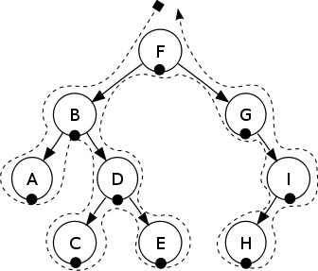
Binary Tree Traversals

Slide 2
Binary Tree Traversals
we will look at 4 traversal algorithms for binary trees:
inorder traversal
postorder traversal
preorder traversal
breadthFirst traversal

Slide 3
Example
we will apply each traversal method to the following tree

Slide 4

Inorder Traversal
inorder traversal: left-root-right
traverse the left subtree
visit the root
traverse the right subtree
https://en.wikipedia.org/wiki/Tree_traversal

Slide 5
Inorder Traversal of Example
inorder traversal: left-root-right
D B I G K J E H A C F

Slide 6
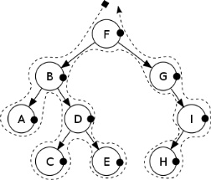
Postorder Traversal
postorder traversal: left-right-root
traverse the left subtree
traverse the right subtree
visit the root
https://en.wikipedia.org/wiki/Tree_traversal

Slide 7
Postorder Traversal of Example
postorder traversal: left-right-root
D I K J G H E B F C A

Slide 8

Preorder Traversal
preorder traversal: root-left-right
visit the root
traverse the left subtree
traverse the right subtree
https://en.wikipedia.org/wiki/Tree_traversal

Slide 9
Preorder Traversal of Example
preorder traversal: root-left-right
A B D E G I J K H C F

Slide 10
BreadthFirst Traversal
breadthFirst traversal: level-by-level
visit the root
visit the children of the root in order from left to right
visit the grandchildren of the root from left to right
continue until all elements have been processed

Slide 11
BreadthFirst Traversal of Example
breadthFirst traversal of sample tree
A B C D E F G H I J K

Slide 12
Traversing Binary Search Trees
the tree we are using as an example is a binary tree, but it is NOT a binary search tree (BST)
when applied to a BST, an inorder traversal has an interesting property: it produces a list that is sorted from lowest to highest

Slide 13
Binary Tree Traversals
The End

